Slide 1
Developing Eye Gaze Interactions in under 5 minutes using MRTK3
Deyrel Diaz

Slide 2
Why?
Don’t need a physical Hololens device
Can create easy prototypes that use eye-tracking, hand-tracking, speech input, or a combination of all three
Really easy to make with basic Unity Engine fundamentals
Opportunities to use the Extended Eye tracking SDK and get more detailed eye tracking information (Left, Right, and Combined)
No code required!! Seriously!!

Slide 3
Prerequisites
Getting everything set-up can take about 30 minutes - 1 hour
Need Unity and Visual Studio downloaded
Have MRTK3 correctly downloaded into your Unity project
Have everything correctly set up in Visual Studio
Have all the project settings and build settings correctly configured for Microsoft Hololens with an Eye gaze interaction Profile

Slide 4

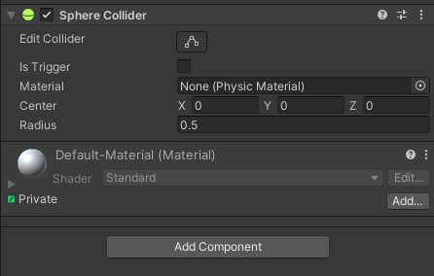
Setting up the Scene
Create a new 3D scene
Make sure Universal Windows Build Platform is supported for this unity version
Delete the ‘Main Camera’ gameobject if there is one
Create an empty gameobject at (0, 0, 0) and name it “MixedRealityPlayspace” (MRPs)
All interactable gameobjects should be a child of this gameobject (some MRTK things require it)
Create a primitive gameobject (e.g., sphere) at (0, 1.5, 4)
Child it to the MRPs
Make sure this gameobject has a collider component (see inspector pane)

Slide 5
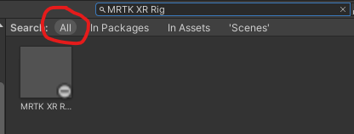
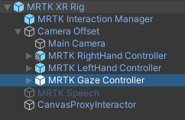
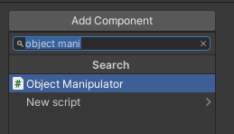
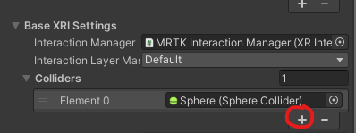
Setting-up MRTK Interactions
Search for “MRTK XR Rig” prefab in the project pane
Drag it into the scene and Child it to the MRPs
Make sure is has the ‘MRTK Gaze Controller’ child gameobject
On the Sphere, add an ‘Object Manipulator Component’
A ‘Constraint Manager’ component is automatically added
Within the Object Manipulator, add in the collider to the Collider array parameter using the ‘+’ icon

Slide 6
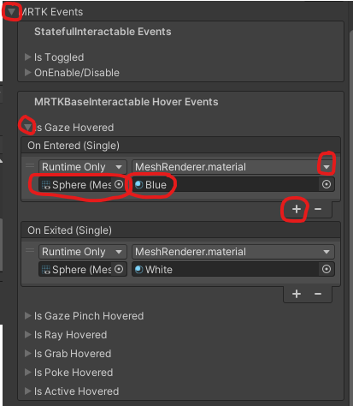
Finalizing MRTK Eye-tracking Event
Create two materials: one blue and one white
Within the Object Manipulator, expand the ‘MRTK Events’ dropdown
Expand the ‘Is Gaze Hovered’ event dropdown
Add an ‘On Entered’ event using the ‘+’ icon
Add an ‘On Exited’ event using the ‘+’ icon
Drag in the Sphere Gameobject in the ‘None’ area for both of these
Add ‘Mesh Renderer > Material material’ where it says ‘No Function’
Drag in the blue material for the entered event and white for the exited event

Slide 7
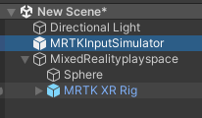


Testing
Search for the “MRTK Input Simulator” prefab in the project pane
Add it into the scene, but OUTSIDE of the MRPs hierarchy
Simply hit the play button to test
Hold down right mouse button to move gaze direction
Arrow keys to move camera position
Space bar for hand interactions
See the magic happen!! *Play Video*

Slide 8
Tutorial Video*
*(>5 minutes with explanations)

Slide 9
What will you create?

